Slide 1
(Monica) Final Capstone Showcase: QVX Nodes in KNIME
Sponsor: Prabhat Vaish and Analytiq(Vidya)
Project Manager: Monica Sangam
Team Member: Matthew Belanger

Slide 2
(Monica) KNIME and QLIKVIEW Overview
KNIME is an open source data analytics, reporting and integration platform.
KNIME can uses adapters to load data from different source types like Big Data, Oracle, MySQL, MS-SQL. Excel, CSV.
QlikView/QlikSense is a data analytics platform which uses a proprietary data format (QVD) and also support a data exchange format (QVX).
Project Goal is to design and implement a KNIME QVX file adapter/node.

Slide 3
(Monica) KNIME QVX Node Scope and Requirements
QVX Reader KNIME Node
Reads QVX file and transforms into KNIME node data at the output port
QVX Writer KNIME Node
Input port accepts a KNIME node data table
Use the KNIME node data table to generate a QVX file

Slide 4
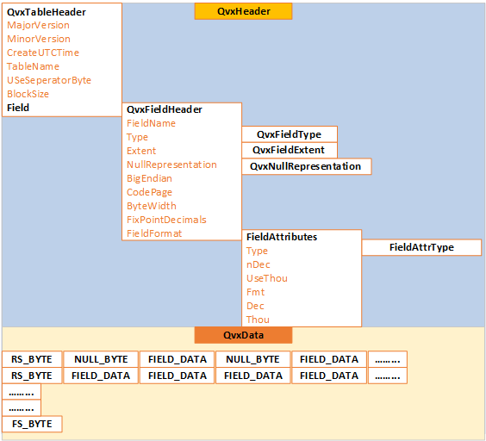
(Monica) QVX File Format

Slide 5
(Matt) Project Strategy Details
Node development
In Eclipse, install KNIME plug-in
New Node Wizard
Modify node to include basic configuration options
Add more advanced configuration options
Write code that convert data tables to QVX form and vice versa
Use JAXB library to encode/decode XML
The XSD specifies the XML format of the data portion of the QVX file

Slide 6
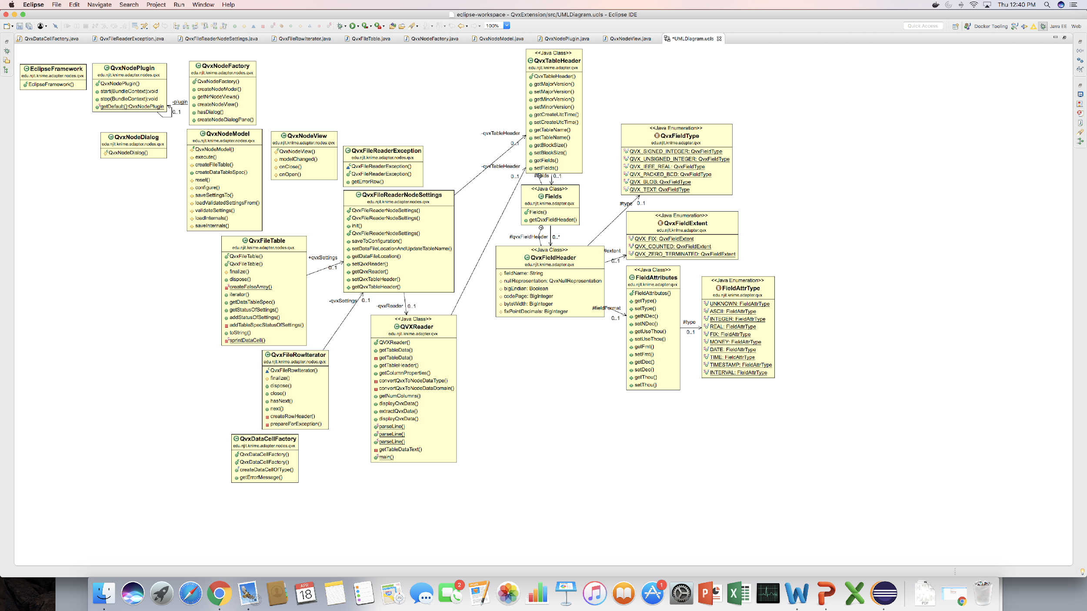
(Matt) Project Strategy and Class Diagrams

Slide 7
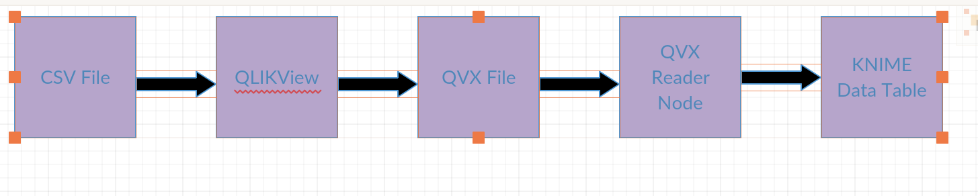
(Monica) Diagram for QVX Reader
Including testing by outputting the data into a KNIME data table, and verifying the data is what we expect it to be.

Slide 8
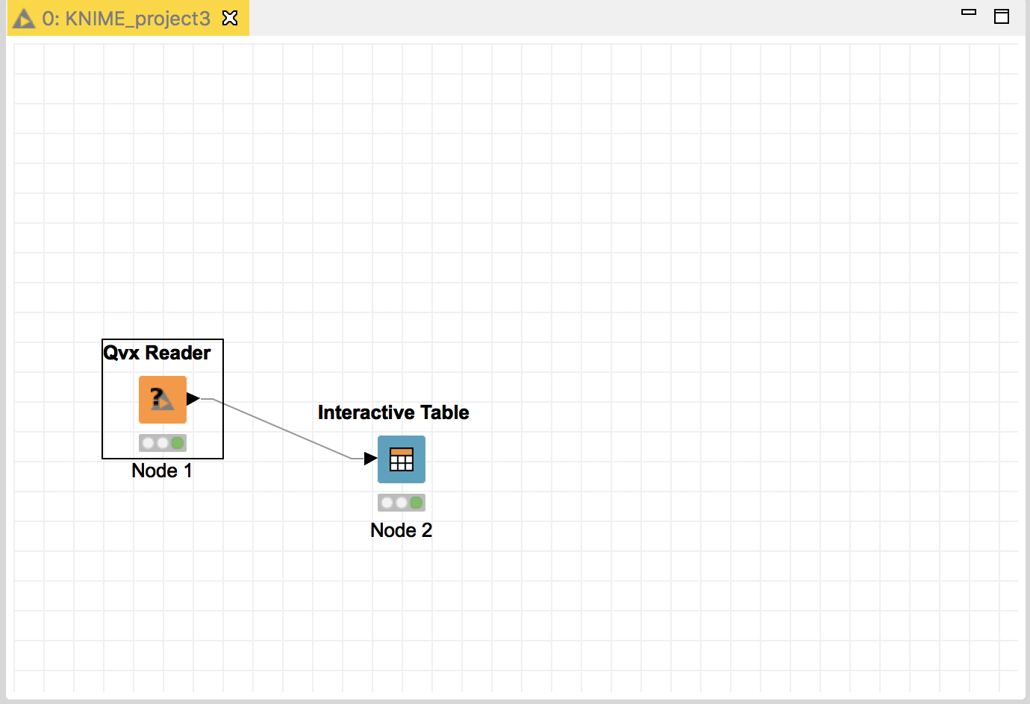
(Monica) Prototypes for QVX Reader

Slide 9
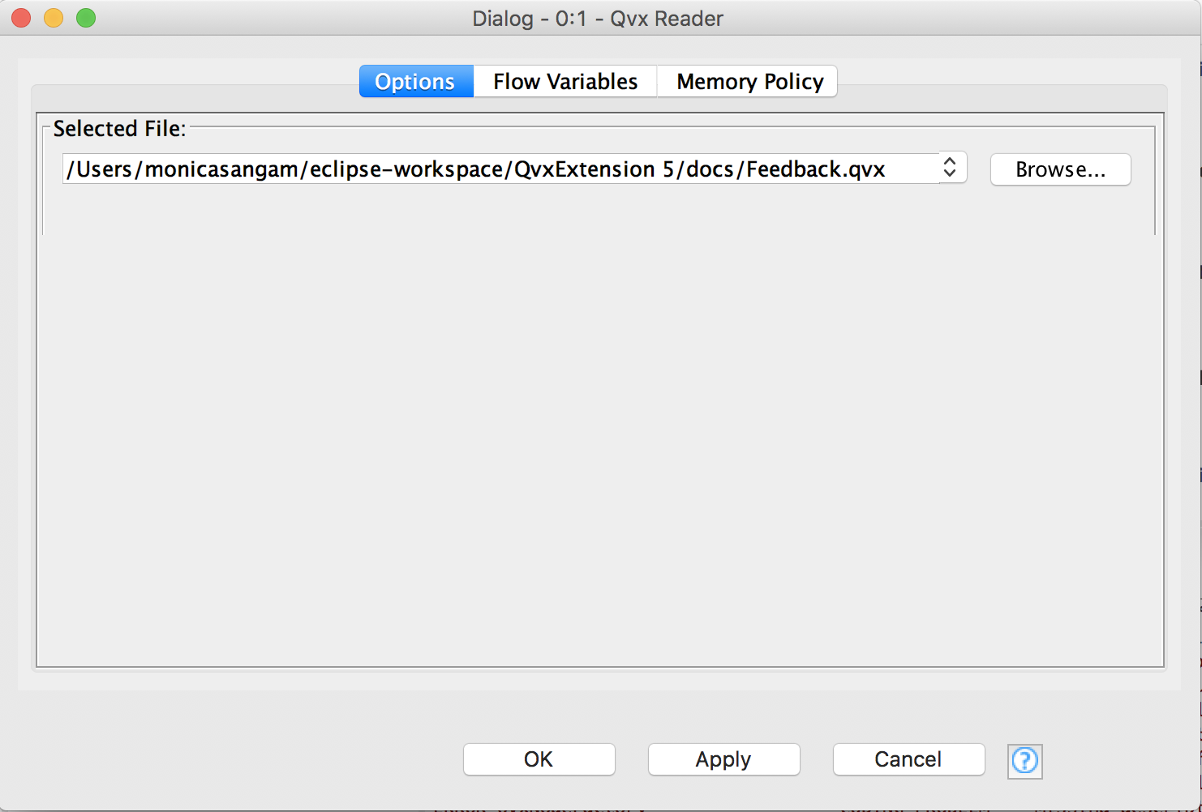
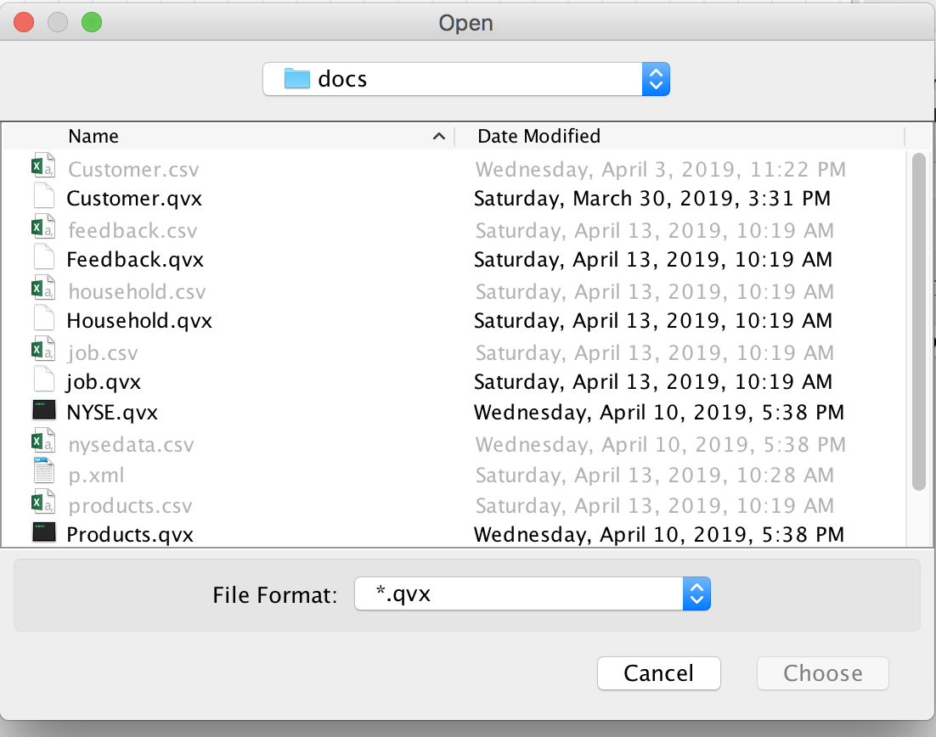
(Monica) Prototypes for QVX Reader

Slide 10
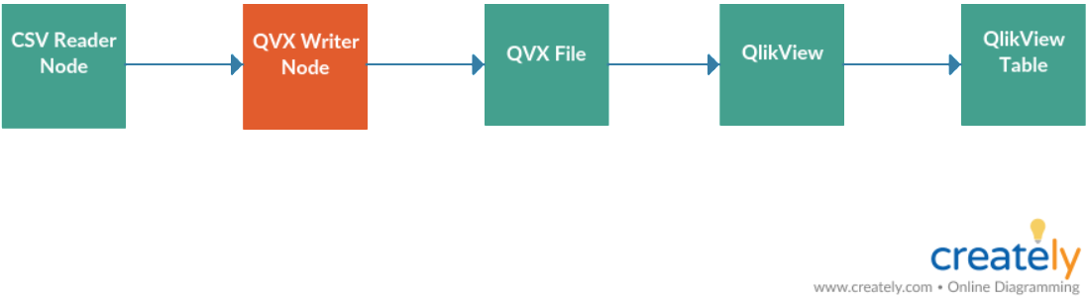
(Matt) Diagram for QVX Writer

Slide 11
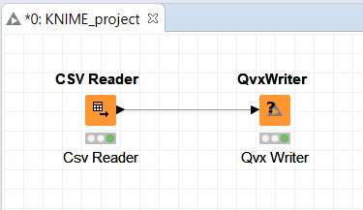
(Matt)Prototypes for QVX Writer

Slide 12
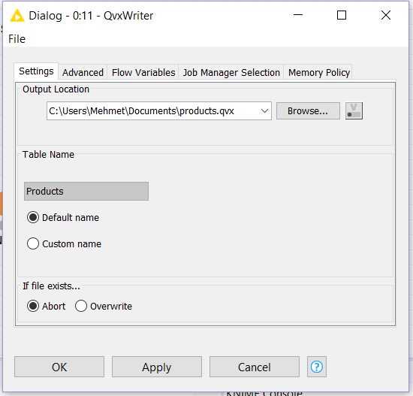
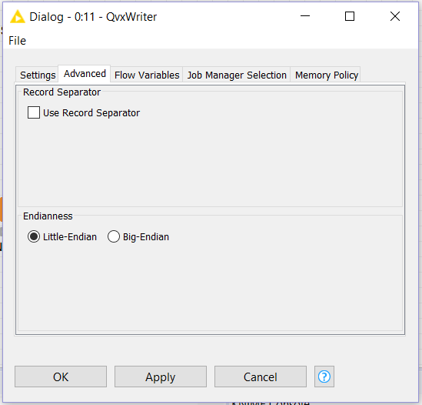
(Matt) Prototypes for QVX Writer

Slide 13
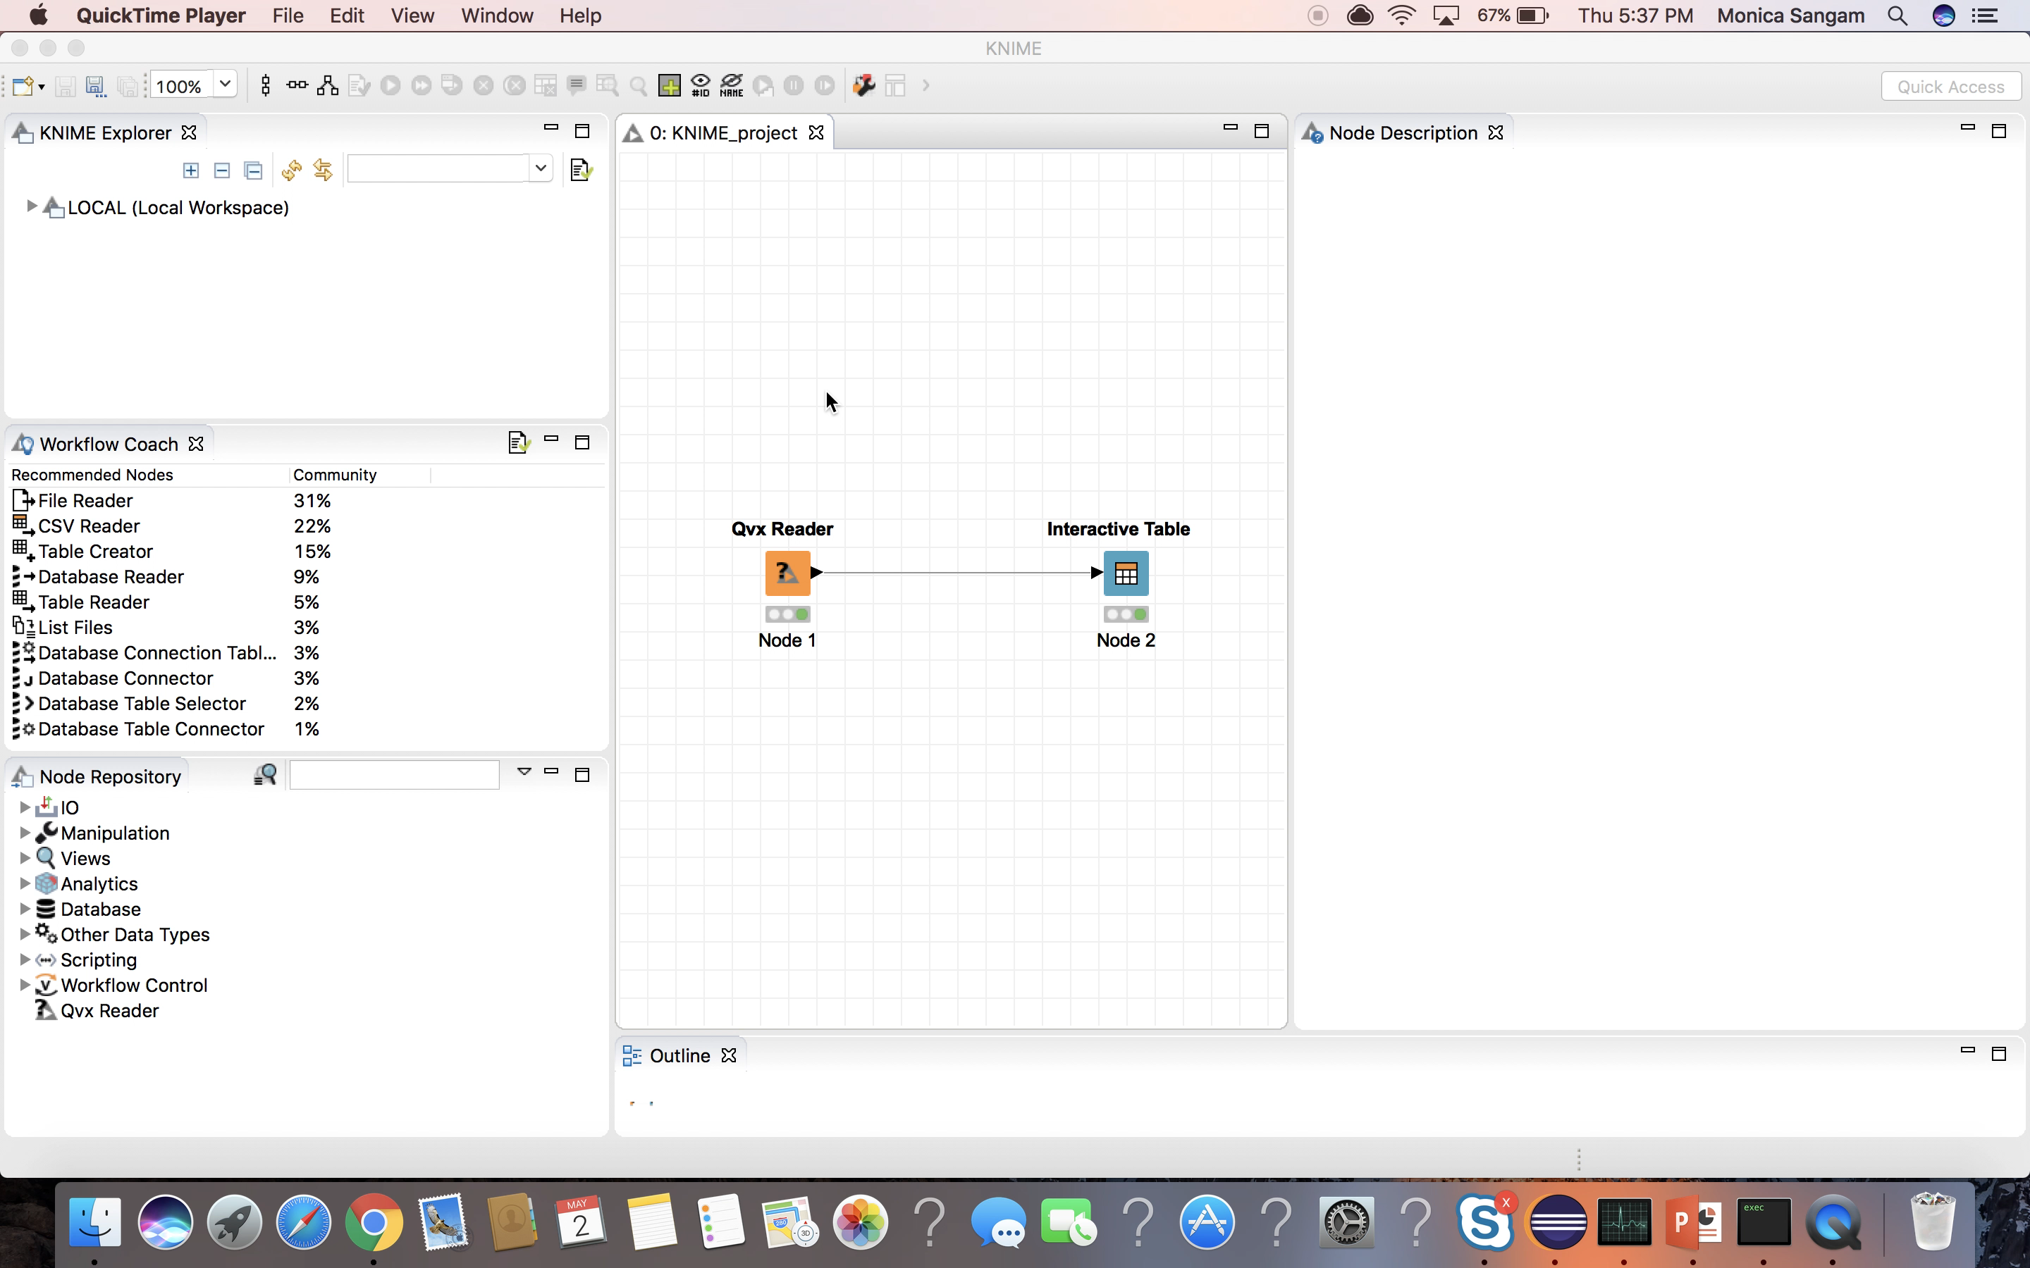
(Monica) KNIME QVX Reader Demo

Slide 14
(Matt) KNIME QVX Writer Demo
Video

Slide 15
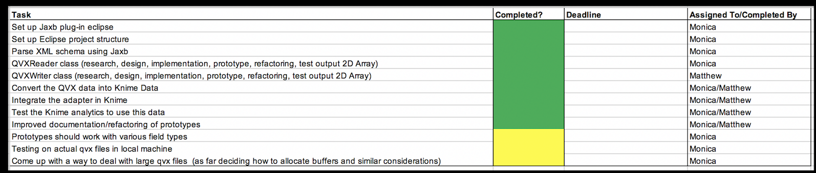
(Matt) Work Breakdown Schedule or Scrum Meeting

Slide 16
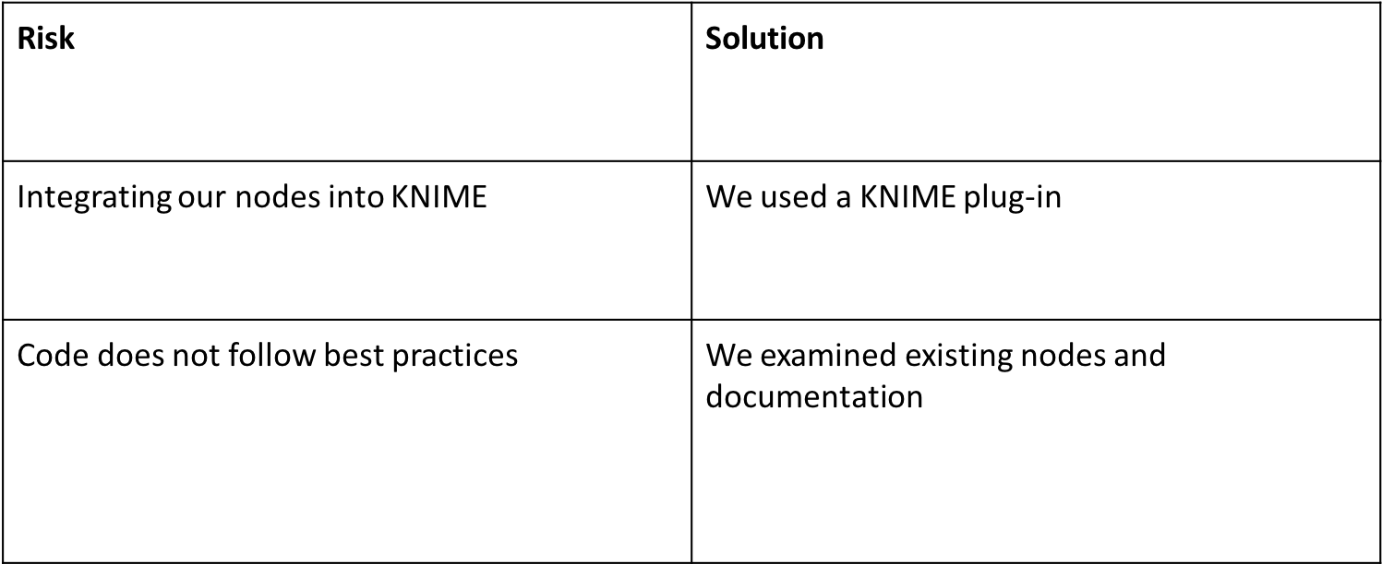
(Matt) Risk Management

Slide 17
(Matt) Stakeholders
NJIT
KNIME users
Qlik Tech and Qlik Sense

Slide 18
(Matt) Ability to validate
We consistently met each other by having follow up meetings to discuss how we can improve on the program each week through two different types of social media
Skype for Business
GroupMe
Zoom
Able to assign each other a duty or responsibility to complete a certain task
Evaluate each other progress on their work
Clarify any issues or problems we faced while developing our program
Meet with the professor every two weeks to show our progress and update the professor with what we have completed in the project so far

Slide 19
(Monica )Conclusion
Successful prototypes
Add all the configuration options to read and write to different QVX files in QLIKVIEW and QLIKSENSE
Implement an Knime Node plugin on Java(Eclipse framework)

